Slide 1
Center for Dark Energy Biosphere Investigations
Some like it hot … and toxic!
Jan Amend University of Southern California
COSEE-West
30 November 2011
Notes:
Many in this audience may be “experienced” enough to remember the film with Tony Curtis, Jack Lemmon, and Marilynn Monroe.
Here, I’m referring to microorganisms, of course – and specifically those living in extreme environments (extremophiles).
I’m not an astronomer or a planetary scientist; I’m a microbial geochemist – predominantly Earth-based.
But I’ve been around planetary scientists enough over the past 12 years or so to know that NASA seeks to find ET life.
One of the truly cross-cutting themes at NASA is Astrobiology – the OoL, early evolution of life, planetary habitability, …
Despite the sexy plans for life detection on some distant body, much of Astrobiology is carried out on Earth.

Slide 2
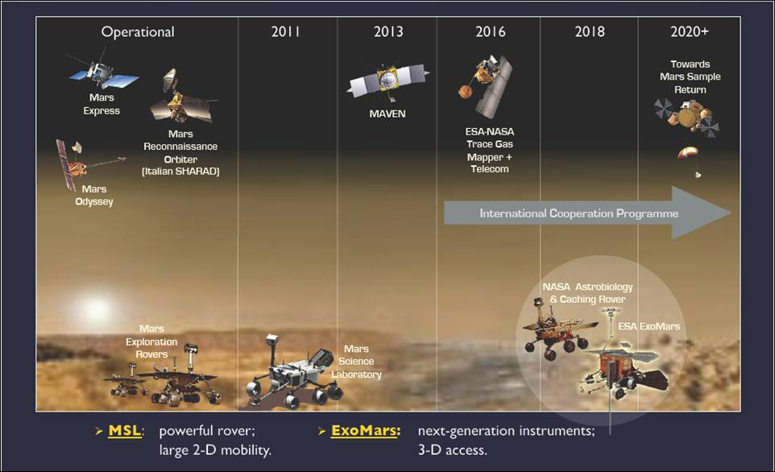
Center for Dark Energy Biosphere Investigations (C-DEBI)
COSEE-West: Amend, SOME LIKE IT HOT … AND TOXIC
Notes:
2

Slide 3
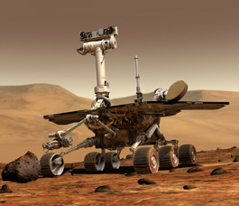
MER
“Primary among the mission's scientific
goals is to search for and characterize a
wide range of rocks and soils that hold
clues to past water activity on Mars.”
Center for Dark Energy Biosphere Investigations (C-DEBI)
COSEE-West: Amend, SOME LIKE IT HOT … AND TOXIC
Notes:
3

Slide 4
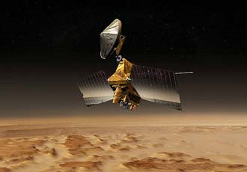
MRO
“…history of water on Mars.”
Center for Dark Energy Biosphere Investigations (C-DEBI)
COSEE-West: Amend, SOME LIKE IT HOT … AND TOXIC
Notes:
4

Slide 5
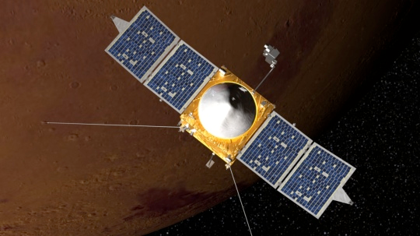
MAVEN
“…to determine the role that loss of volatile
compounds—such as carbon dioxide,
nitrogen dioxide, and water—from the Mars
atmosphere to space has played through
time, giving insight into the history of Mars'
atmosphere and climate, liquid water, and
planetary habitability.”
Center for Dark Energy Biosphere Investigations (C-DEBI)
COSEE-West: Amend, SOME LIKE IT HOT … AND TOXIC
Notes:
5

Slide 6
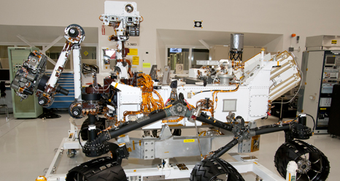
MSL
“NASA rover Curiosity is a $2.5 billion nuclear-powered machine … in hopes of finding evidence of microscopic life. It is the size of a Mini Cooper, and has a large robot arm, a weather station, a laser that can vaporize rocks at seven meters, a percussive drill, and 4.8kg of plutonium-238.”
Center for Dark Energy Biosphere Investigations (C-DEBI)
COSEE-West: Amend, SOME LIKE IT HOT … AND TOXIC
Notes:
6

Slide 7
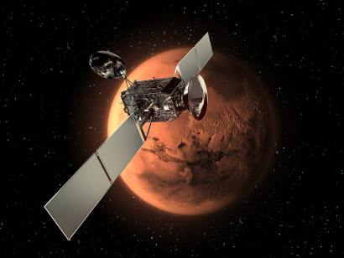
ExoMars
“The joint European-American mission, ExoMars Trace Gas Orbiter, will seek faint gaseous clues about possible life on Mars."
Center for Dark Energy Biosphere Investigations (C-DEBI)
COSEE-West: Amend, SOME LIKE IT HOT … AND TOXIC
Notes:
7

Slide 8
Microbes,
not Tigers or Tulips!
Center for Dark Energy Biosphere Investigations (C-DEBI)
COSEE-West: Amend, SOME LIKE IT HOT … AND TOXIC
Notes:
8

Slide 9
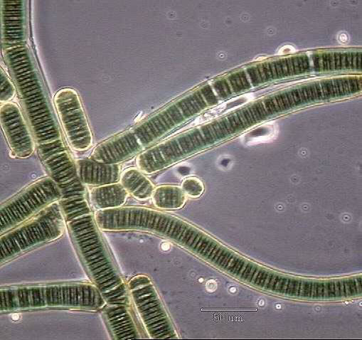
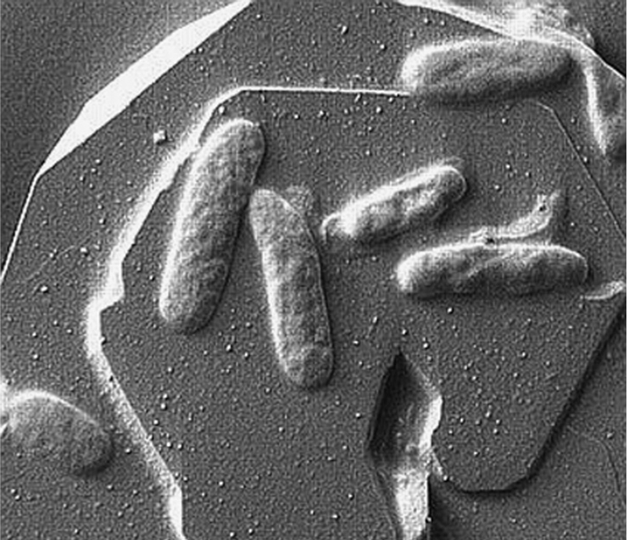
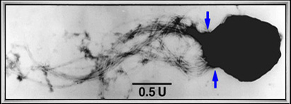
Center for Dark Energy Biosphere Investigations (C-DEBI)
COSEE-West: Amend, SOME LIKE IT HOT … AND TOXIC
Notes:
9

Slide 10
1. Origin of Life 2. Limits of Life 3. Deep-Subsurface Biosphere 4. Shallow-Sea Vents
Center for Dark Energy Biosphere Investigations (C-DEBI)
COSEE-West: Amend, SOME LIKE IT HOT … AND TOXIC
Notes:
10

Slide 11
1. Origin of Life 2. Limits of Life 3. Deep-Subsurface Biosphere 4. Shallow-Sea Vents
Center for Dark Energy Biosphere Investigations (C-DEBI)
COSEE-West: Amend, SOME LIKE IT HOT … AND TOXIC
Notes:
11

Slide 12
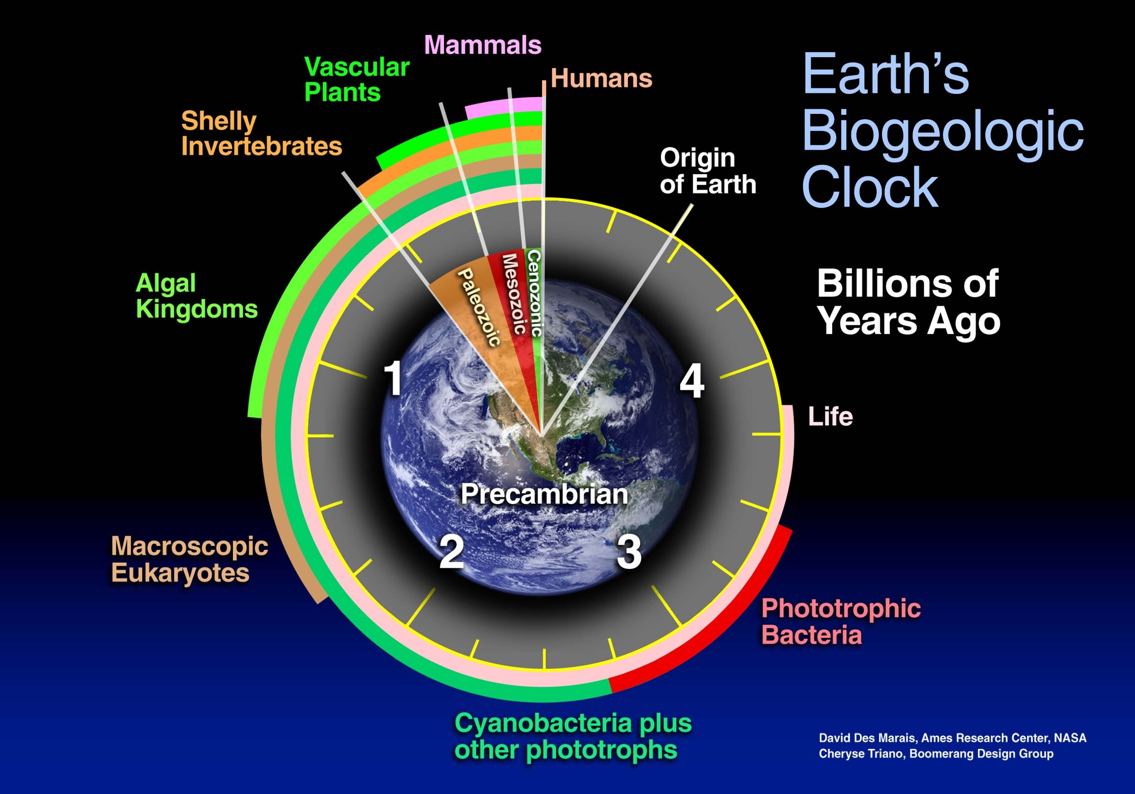
Title
Subtitle
Text
Center for Dark Energy Biosphere Investigations (C-DEBI)
COSEE-West: Amend, SOME LIKE IT HOT … AND TOXIC
Notes:
12

Slide 13
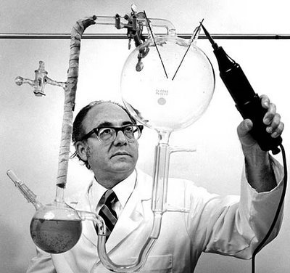
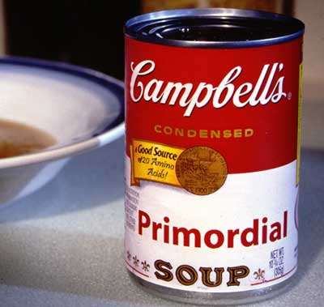
The “spark discharge” experiment
Stanley Miller
Gases (CH₄, NH₃, H₂) + H₂O
Amino Acids
Center for Dark Energy Biosphere Investigations (C-DEBI)
COSEE-West: Amend, SOME LIKE IT HOT … AND TOXIC
Notes:
13

Slide 14
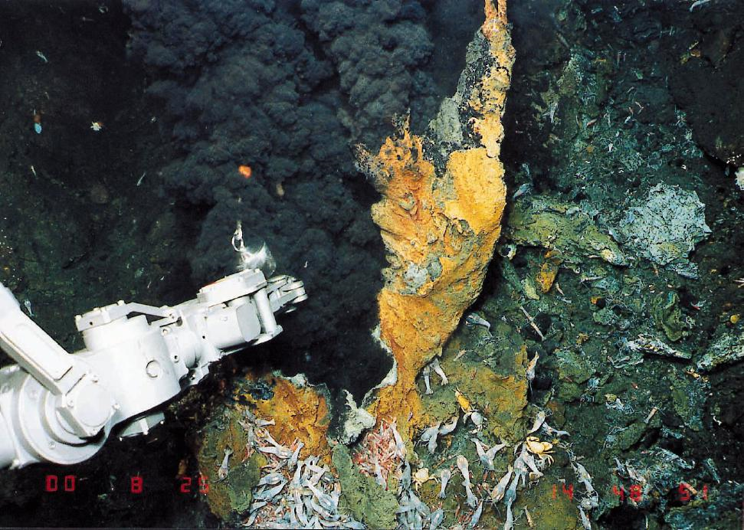
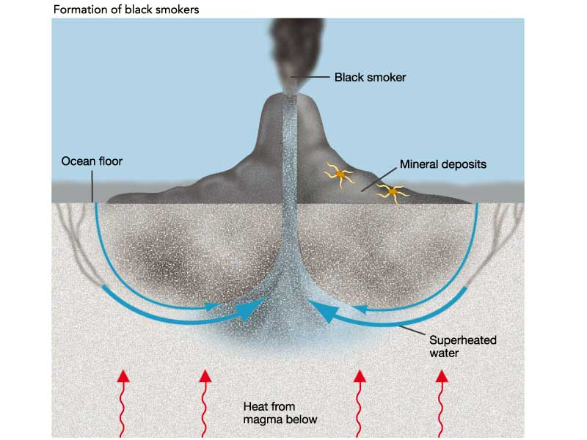
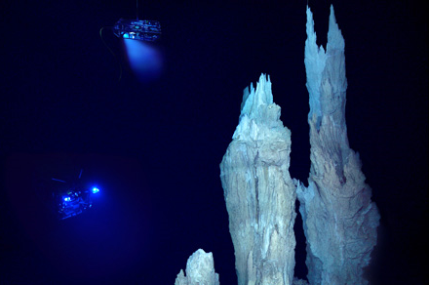
Hydrothermal Systems
ATMOSPHERE
1-10 bar
CO₂ > N₂ > CO, CH₄
OCEAN
~25 °C
pH ~5
H₂
H₂S
100 °C
pH ~10
Center for Dark Energy Biosphere Investigations (C-DEBI)
COSEE-West: Amend, SOME LIKE IT HOT … AND TOXIC
Notes:
14

Slide 15
Primordial Soup
Hydrothermal
System
ATMOSPHERE
OCEAN
First Life:
Heterotroph
Psychrophile
First Life:
Autotroph
Thermophile
Center for Dark Energy Biosphere Investigations (C-DEBI)
COSEE-West: Amend, SOME LIKE IT HOT … AND TOXIC
Notes:
15

Slide 16
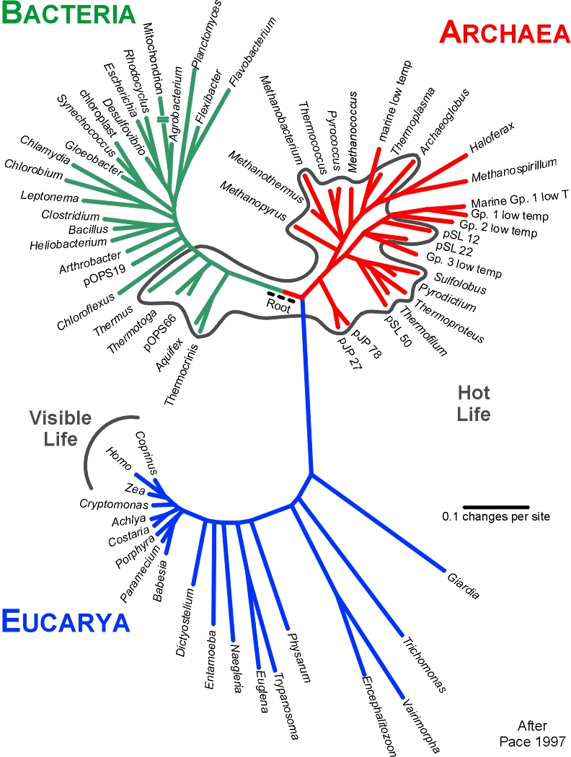
Title
Subtitle
Text
Center for Dark Energy Biosphere Investigations (C-DEBI)
COSEE-West: Amend, SOME LIKE IT HOT … AND TOXIC
Notes:
16

Slide 17
Title
Subtitle
Text
Center for Dark Energy Biosphere Investigations (C-DEBI)
COSEE-West: Amend, SOME LIKE IT HOT … AND TOXIC
Notes:
17

Slide 18
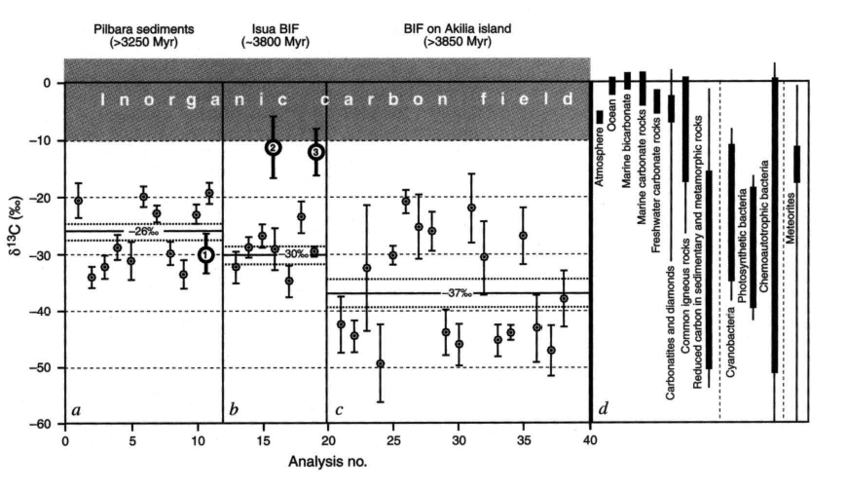
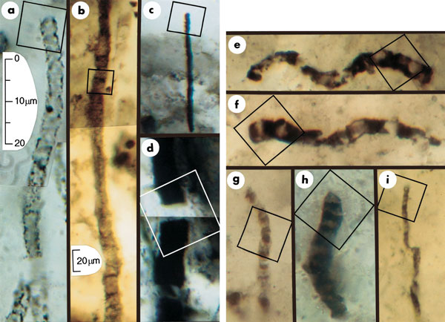
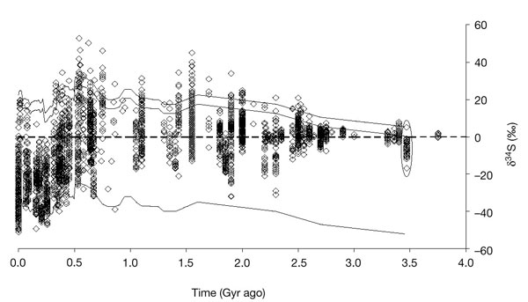
Schopf et al., 2002, Nature
Some of the evidence for early life
Mojzsis et al., 1996, Nature
Shen et al., 2001, Nature
Brocks et al., 1999,
Science
H
2α-Methyl-
hopanes
Center for Dark Energy Biosphere Investigations (C-DEBI)
COSEE-West: Amend, SOME LIKE IT HOT … AND TOXIC
Notes:
~3.85 Ga BIF on Akilia Island, Greenland
~3.5 Ga Apex Cherts, Warrawoona Group in Western Australia.
>3.4 Ga Dresser Formation, Warrawoona Group, Australia
~2.7 Ga Shales, Pilbara Craton, Australia
18

Slide 19
1. Origin of Life 2. Limits of Life 3. Deep-Subsurface Biosphere 4. Shallow-Sea Vents
Center for Dark Energy Biosphere Investigations (C-DEBI)
COSEE-West: Amend, SOME LIKE IT HOT … AND TOXIC
Notes:
19

Slide 20
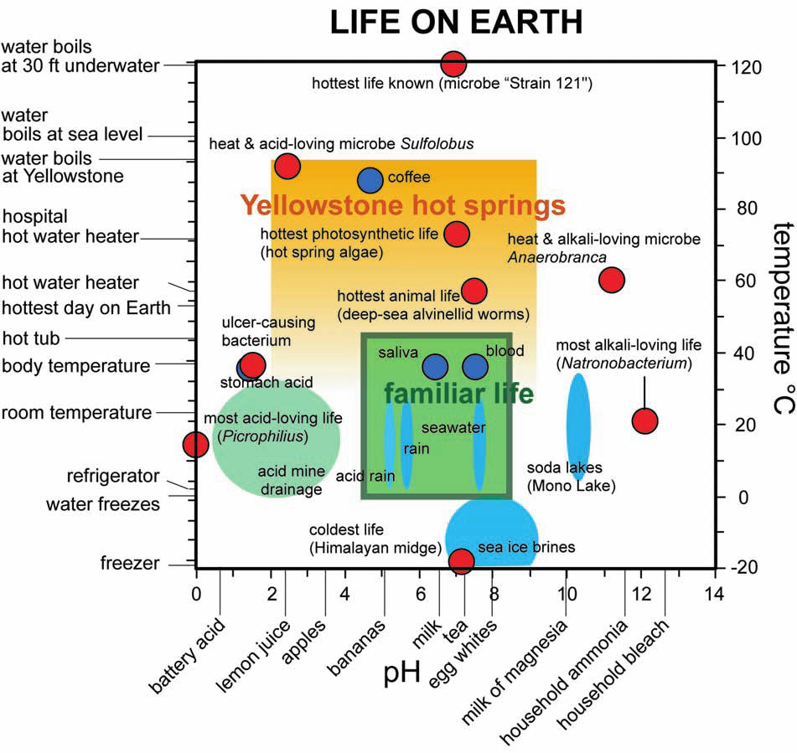
Title
Subtitle
Text
Shock & Holland (2007)
Center for Dark Energy Biosphere Investigations (C-DEBI)
COSEE-West: Amend, SOME LIKE IT HOT … AND TOXIC
Notes:
20

Slide 21
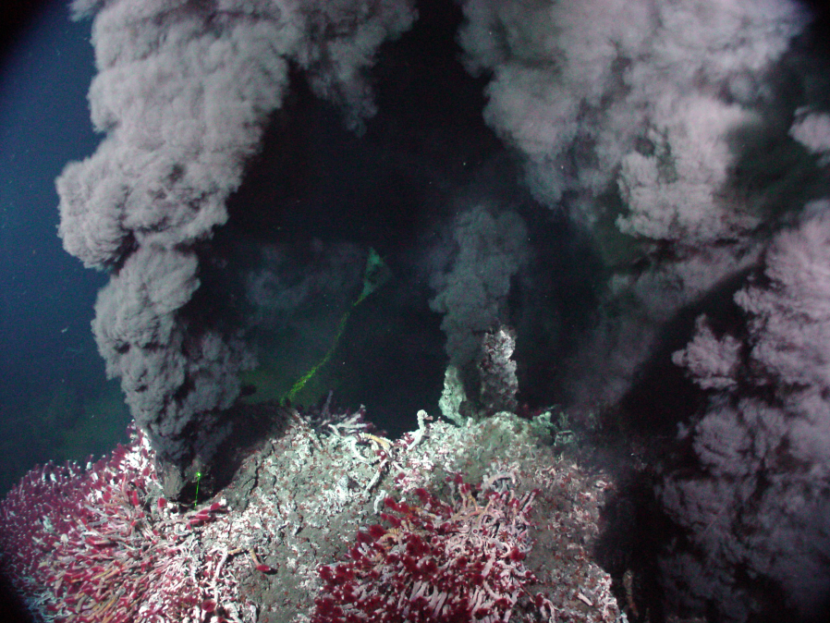
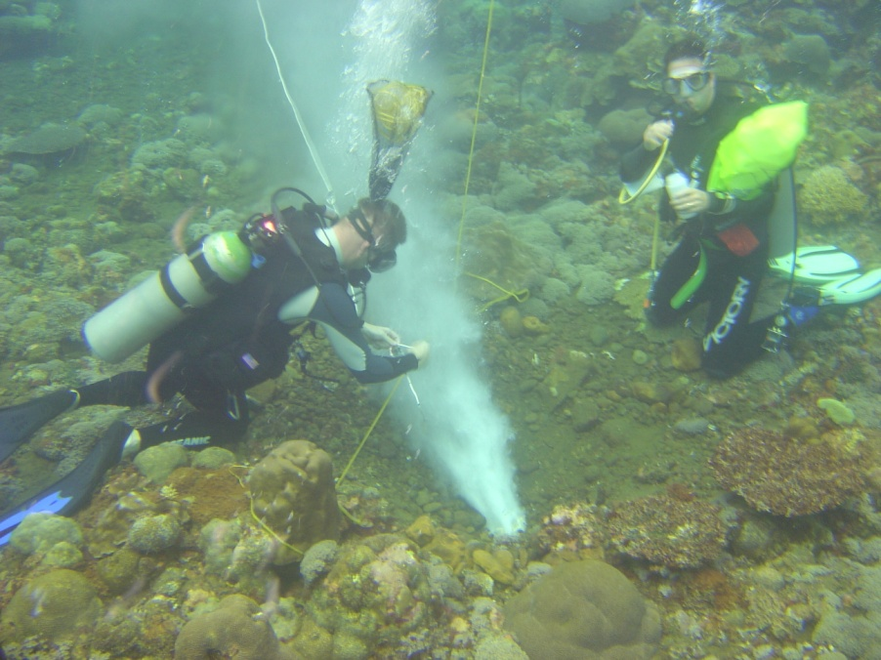
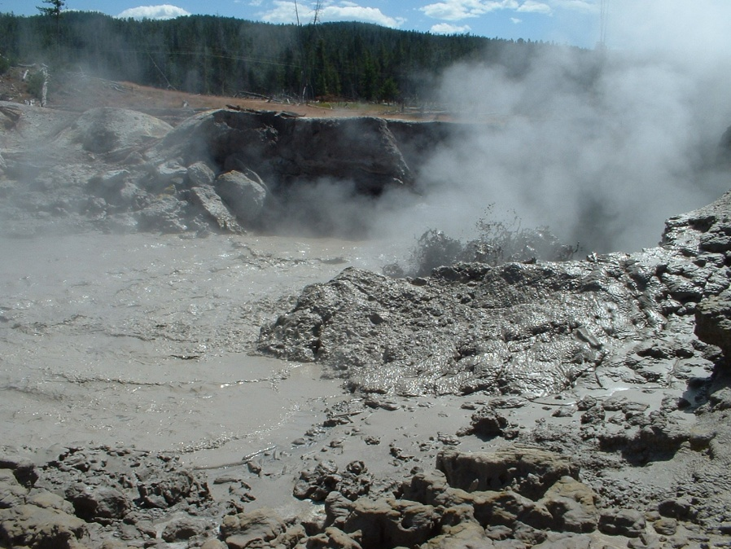
Center for Dark Energy Biosphere Investigations (C-DEBI)
COSEE-West: Amend, SOME LIKE IT HOT … AND TOXIC
Notes:
21

Slide 22
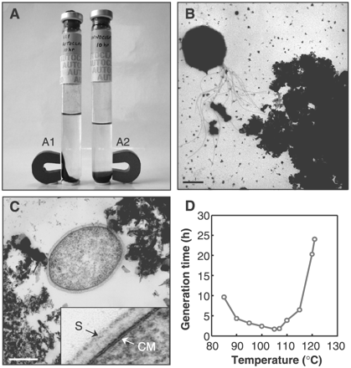
Title
Subtitle
Text
“Extending the Upper Temperature Limit for Life”…to 121 ºC!
Kashefi and Lovley (2003) Science
Center for Dark Energy Biosphere Investigations (C-DEBI)
COSEE-West: Amend, SOME LIKE IT HOT … AND TOXIC
Notes:
22

Slide 23
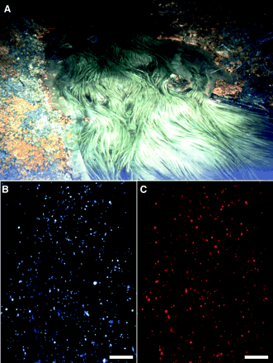
Title
Ferroplasma acidarmanus
Subtitle
pH = 0.5
40 °C
Archaeon
Oxidizes pyrite (FeS₂)
Iron Mountain (CA)
Text
Edwards et al. (2000) Science
Center for Dark Energy Biosphere Investigations (C-DEBI)
COSEE-West: Amend, SOME LIKE IT HOT … AND TOXIC
Notes:
23

Slide 24
1. Origin of Life 2. Limits of Life 3. Deep-Subsurface Biosphere 4. Shallow-Sea Vents
Center for Dark Energy Biosphere Investigations (C-DEBI)
COSEE-West: Amend, SOME LIKE IT HOT … AND TOXIC
Notes:
24

Slide 25
1. Origin of Life 2. Limits of Life 3. Deep-subsurface Biosphere 4. Shallow-sea Hydrothermal Systems
The “Intraterrestrials”
(Archaea and Bacteria)
~1/3 of Earths biomass carbon
Whitman et al. (1998) PNAS
Center for Dark Energy Biosphere Investigations (C-DEBI)
COSEE-West: Amend, SOME LIKE IT HOT … AND TOXIC
Notes:
25

Slide 26
Most Intraterrestrials are Below the Bottom of the Oceans
Text
ONLY sediments
NO rocks
Center for Dark Energy Biosphere Investigations (C-DEBI)
COSEE-West: Amend, SOME LIKE IT HOT … AND TOXIC
Notes:
26

Slide 27
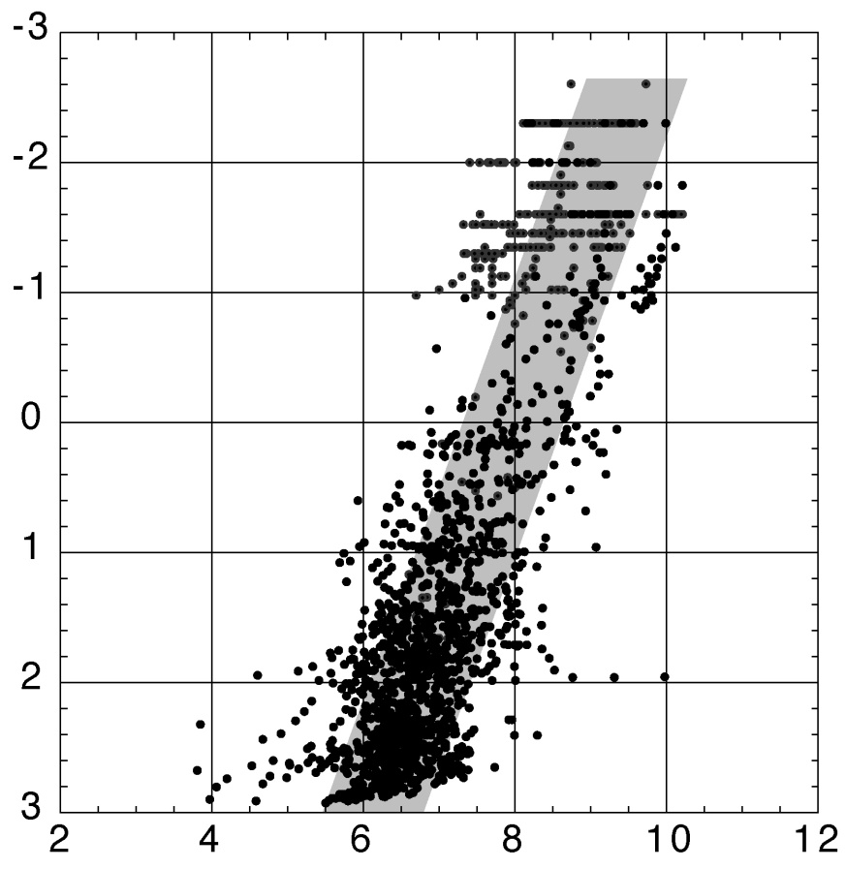
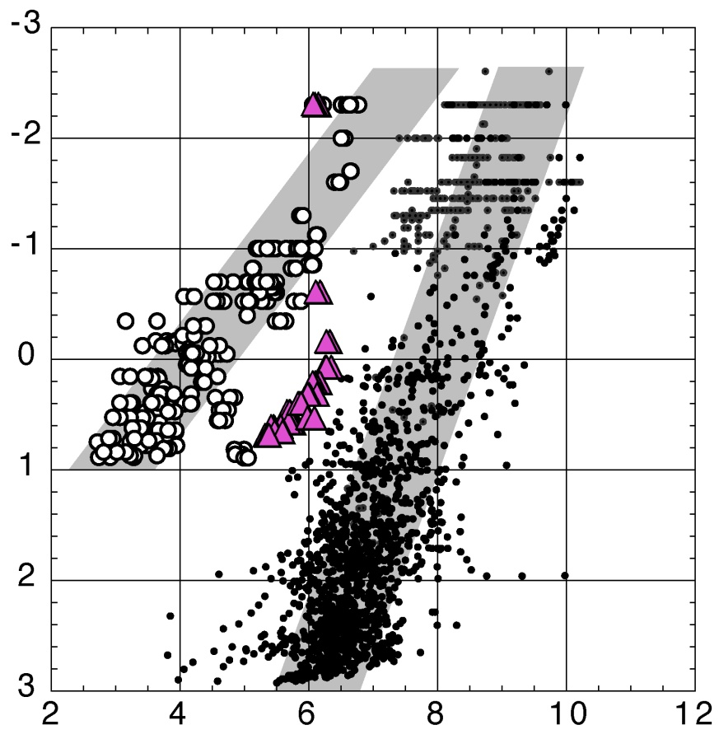
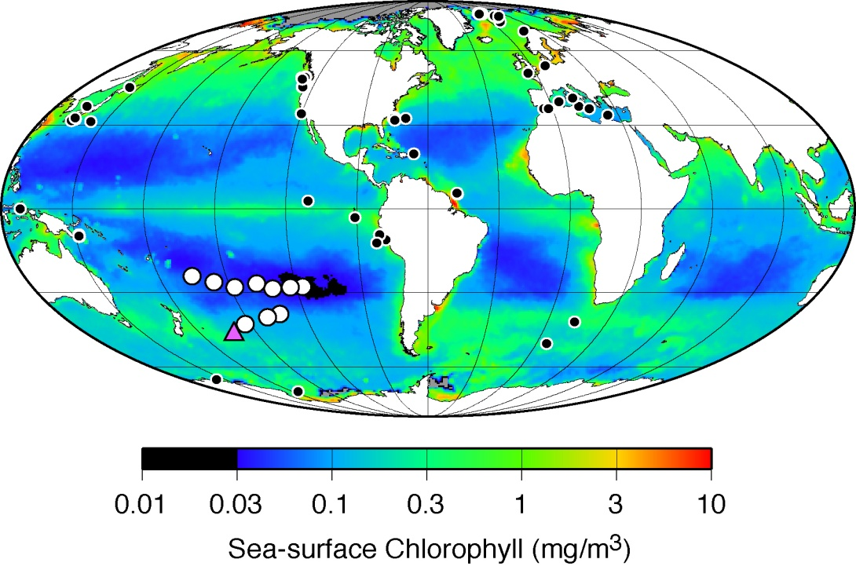
SPG data
log Depth (MBSF)
Previous data
SeaWiFS Chl-a (mg/m³)
log Cell concentration (cells/cm³)
Center for Dark Energy Biosphere Investigations (C-DEBI)
COSEE-West: Amend, SOME LIKE IT HOT … AND TOXIC
Notes:
27

Slide 28
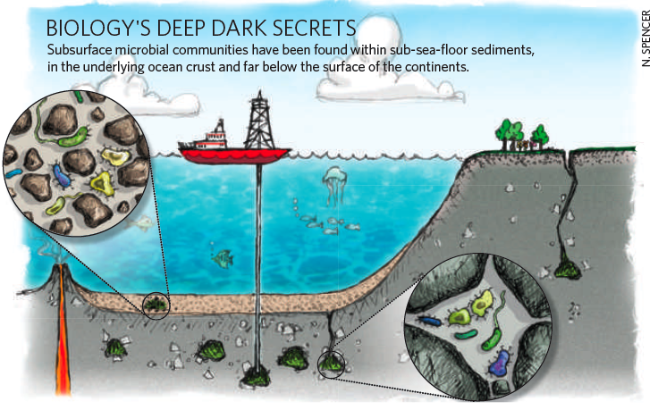
Title
Subtitle
NATURE Vol 459 11 June 2009
Text
Most data collected here
ODP Leg 201 in 2002 collected first data here
Here we have almost no data
Center for Dark Energy Biosphere Investigations (C-DEBI)
COSEE-West: Amend, SOME LIKE IT HOT … AND TOXIC
Notes:
28

Slide 29
1. Origin of Life 2. Limits of Life 3. Deep-Subsurface Biosphere 4. Shallow-Sea Vents
Center for Dark Energy Biosphere Investigations (C-DEBI)
COSEE-West: Amend, SOME LIKE IT HOT … AND TOXIC
Notes:
29

Slide 30
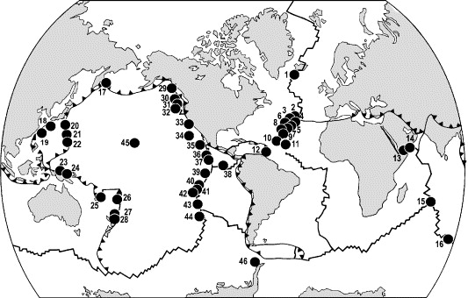
Deep-Sea
Hydrothermal
Systems
Tarasov et al. (2005)
Center for Dark Energy Biosphere Investigations (C-DEBI)
COSEE-West: Amend, SOME LIKE IT HOT … AND TOXIC
Notes:
30

Slide 31
Shallow-Sea
Hydrothermal
Systems
Tarasov et al. (2005)
Center for Dark Energy Biosphere Investigations (C-DEBI)
COSEE-West: Amend, SOME LIKE IT HOT … AND TOXIC
Notes:
31

Slide 32
Shallow-Sea
Hydrothermal
Systems
Milos,
Greece
Panarea,
Italy
Ambitle,
PNG
Tarasov et al. (2005)
Center for Dark Energy Biosphere Investigations (C-DEBI)
COSEE-West: Amend, SOME LIKE IT HOT … AND TOXIC
Notes:
32

Slide 33
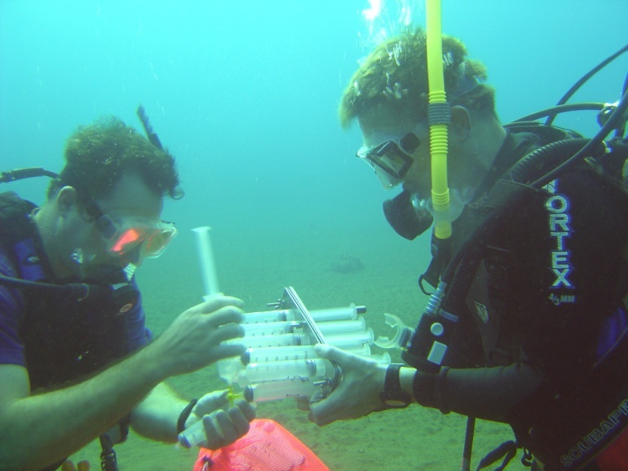
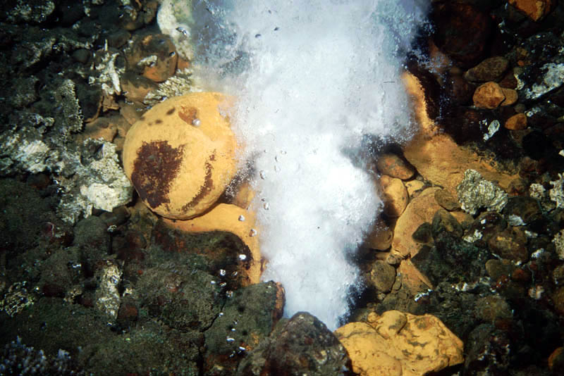
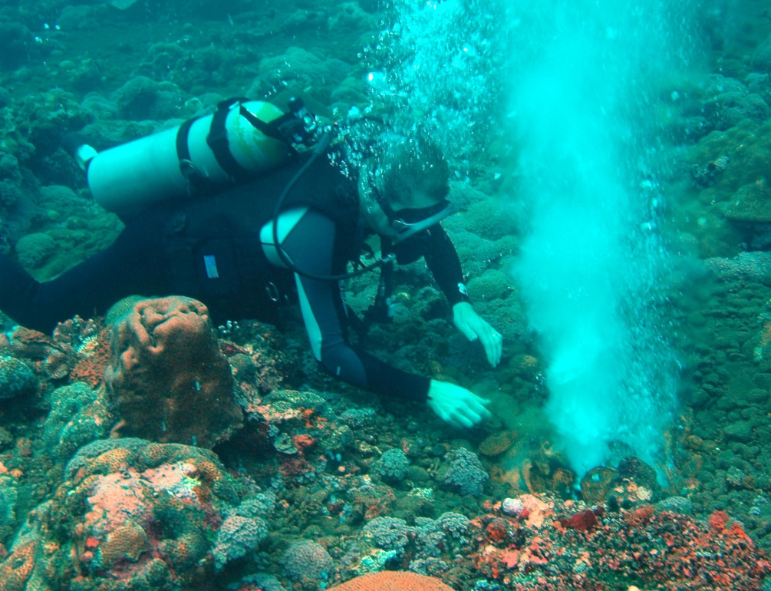
Characteristics of
Shallow-Sea Hydrothermal Systems
Depth <200 m (photic zone)
• Temperatures <150 ºC
Exsolved gas phase (CO₂-rich)
Meteoric water component
Photosynthesis and chemosynthesis
• Readily accessible!!!
Center for Dark Energy Biosphere Investigations (C-DEBI)
COSEE-West: Amend, SOME LIKE IT HOT … AND TOXIC
Notes:
33

Slide 34
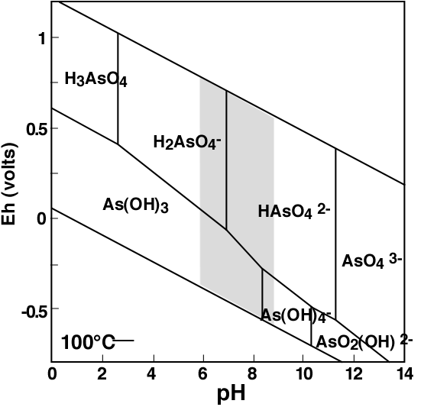
Environmental Geochemistry of Arsenic
Arsenite (As³⁺)
H₃AsO₃°, H₂AsO₃⁻, HAsO₃²⁻, AsO₃³⁻
Arsenate (As⁵⁺)
H₃AsO₄°, H₂AsO₄⁻, HAsO₄²⁻, AsO₄³⁻
Center for Dark Energy Biosphere Investigations (C-DEBI)
COSEE-West: Amend, SOME LIKE IT HOT … AND TOXIC
Notes:
34

Slide 35
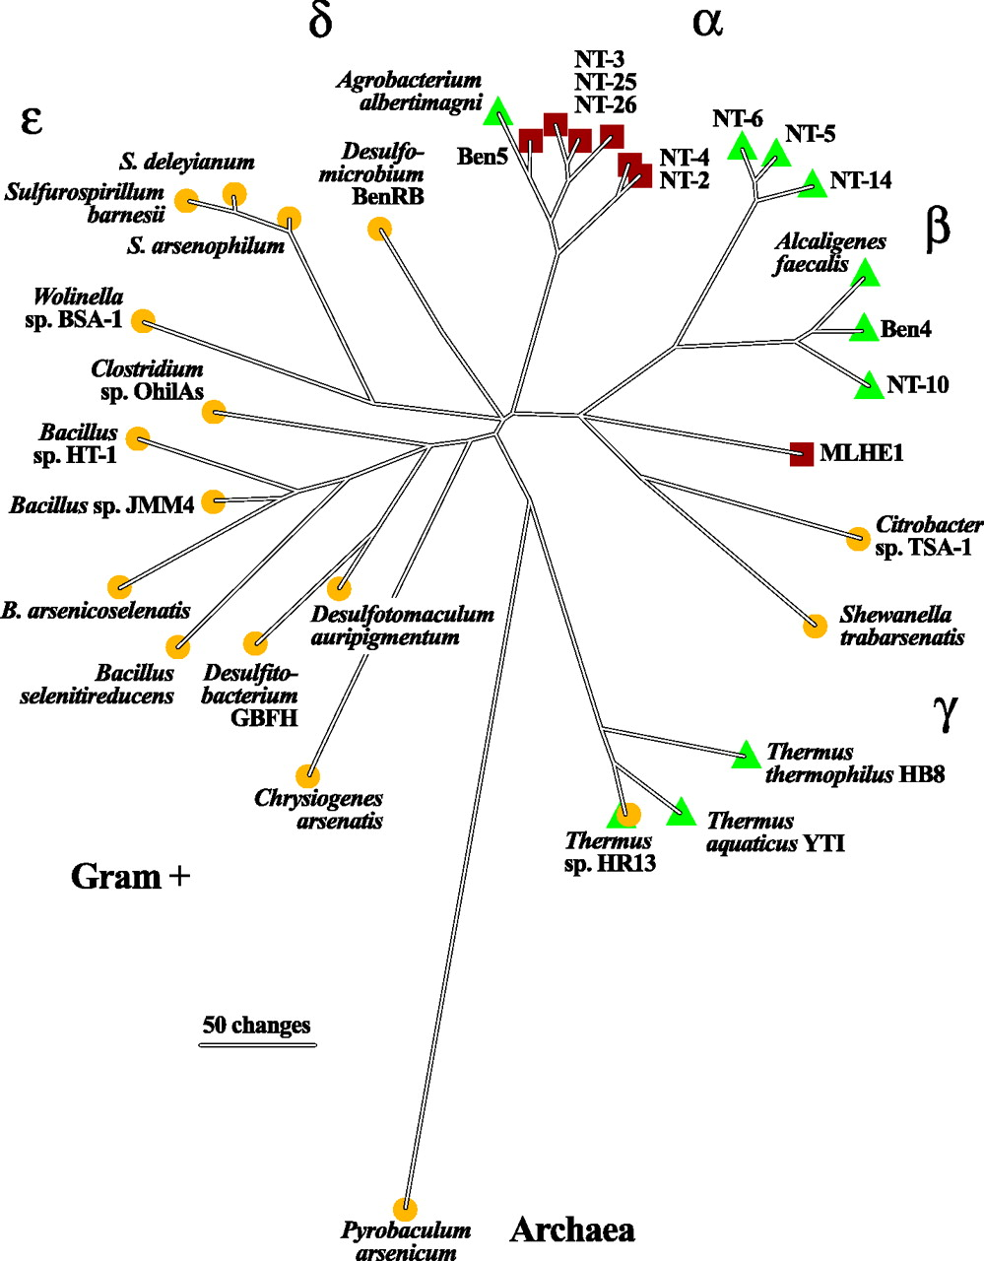
Known Arsenic Metabolizers
As^{V} Reducers
As^{III} Detoxifiers
As^{III} Oxidizers
Oremland and Stolz (2003) Science
Center for Dark Energy Biosphere Investigations (C-DEBI)
COSEE-West: Amend, SOME LIKE IT HOT … AND TOXIC
Notes:
35

Slide 36
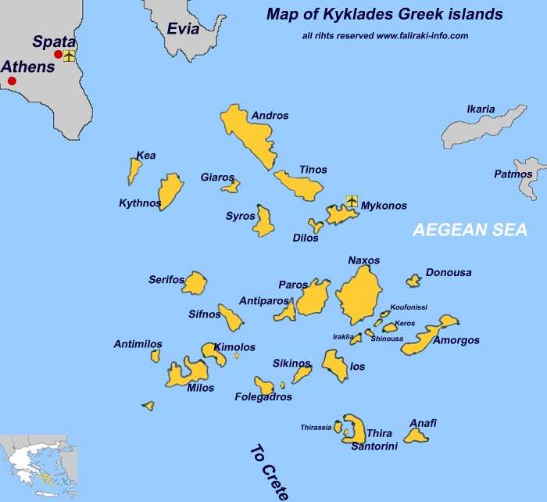
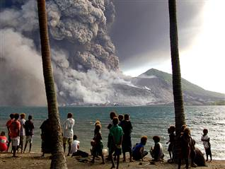
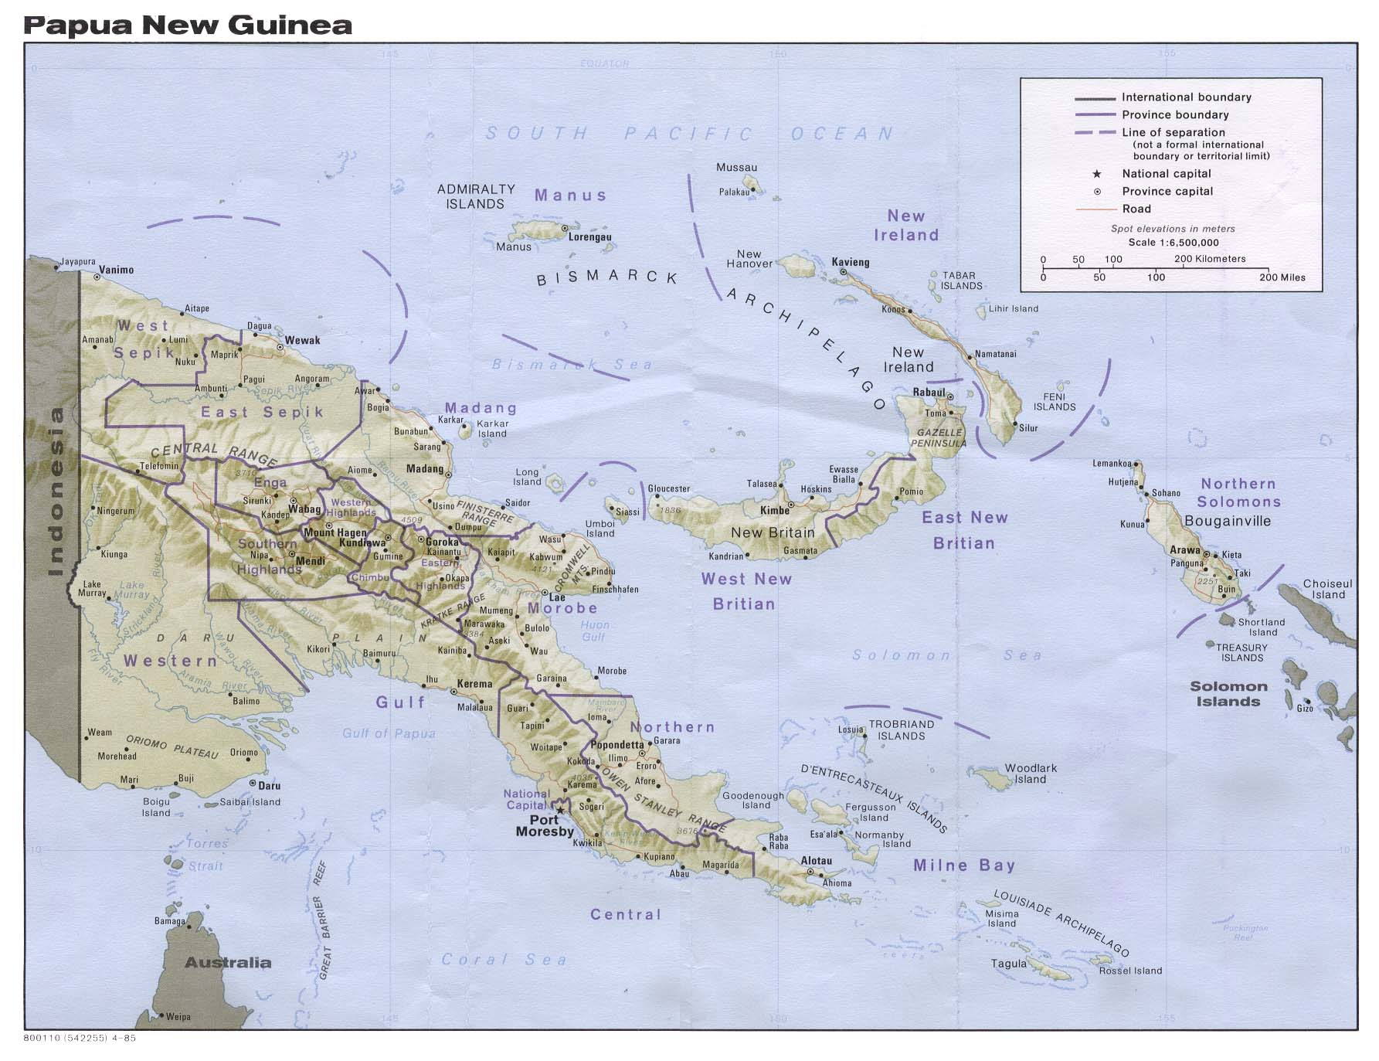
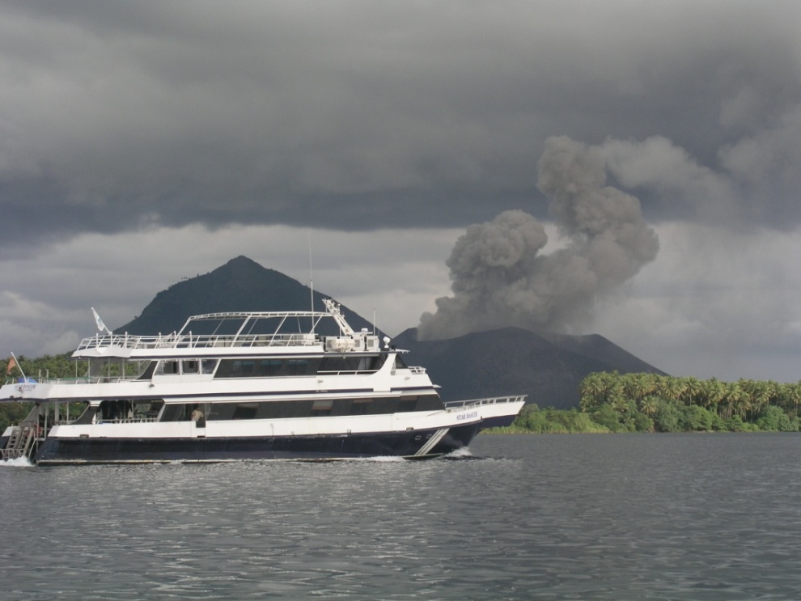
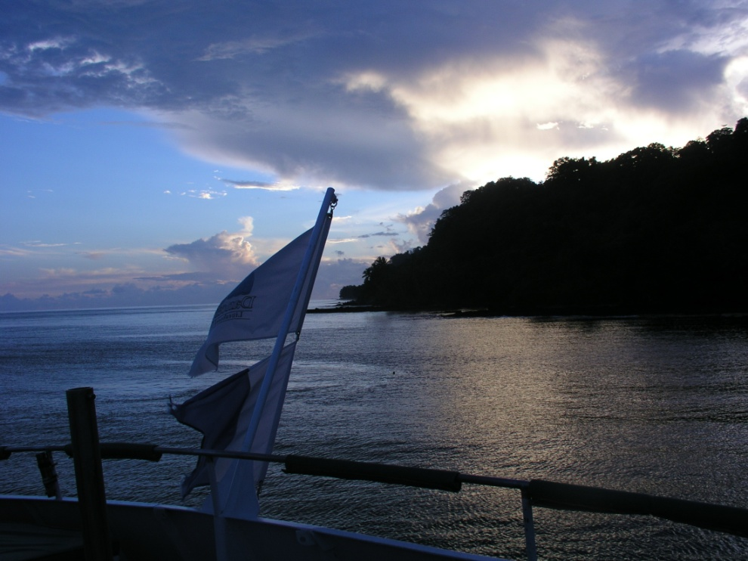
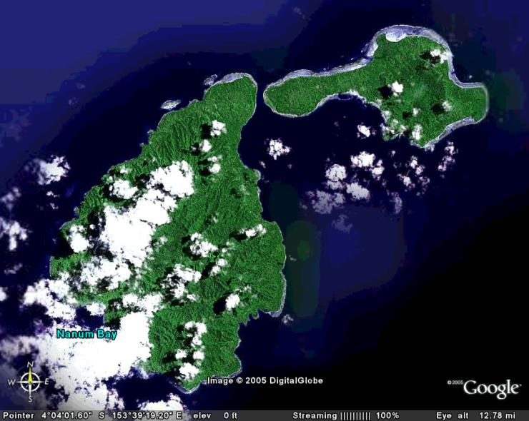
Microbial geochemistry of arsenic (As)
Ambitle Island (PNG)
Milos Island (Greece)
Center for Dark Energy Biosphere Investigations (C-DEBI)
COSEE-West: Amend, SOME LIKE IT HOT … AND TOXIC
Notes:
36

Slide 37
Microbial geochemistry of arsenic (As)
Ambitle Island (PNG)
Milos Island (Greece)
Center for Dark Energy Biosphere Investigations (C-DEBI)
COSEE-West: Amend, SOME LIKE IT HOT … AND TOXIC
Notes:
37

Slide 39
Microbial Arsenic Redox
Arsenic functional genes
Microbial As^{V} reduction
“CH₂O” + H₂AsO₄⁻ + H⁺ = CO₂ + H₃AsO₃
H₃AsO₃
H₂AsO₄⁻

Slide 40
Microbial Arsenic Redox
Arsenic functional genes
Microbial As^{V} reduction
H₂AsO₄⁻ (neg. control)
H₂AsO₄⁻ (killed control)
H₃AsO₃ (killed control)
H₃AsO₃ (neg. control)

Slide 41
Microbial Arsenic Redox
Arsenic functional genes
Microbial As^{V} reduction
“CH₂O” + H₂AsO₄⁻ + H⁺ = CO₂ + H₃AsO₃
H₃AsO₃
H₃AsO₃
Cell counts
H₂AsO₄⁻
H₂AsO₄⁻

Slide 42
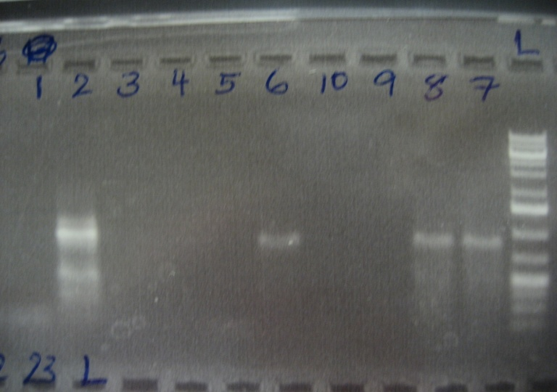
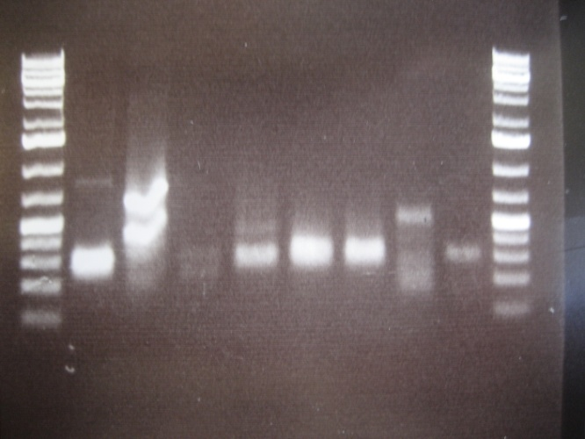
Microbial Arsenic Redox
Arsenic functional genes
Microbial As^{V} reduction
Bulk DNA screened for:
Arsenite oxidase (aroA)
1: –
2: +
3-5: Vulcano sediments
6-10: PNG sediments
Arsenate reductase (arrA)
1: +
2: –
3: enrichment (30 m)
4-8: sediments
1 2 3 4 5 6 7 8 9 10 L
L 1 2 3 4 5 6 7 8 L

Slide 43
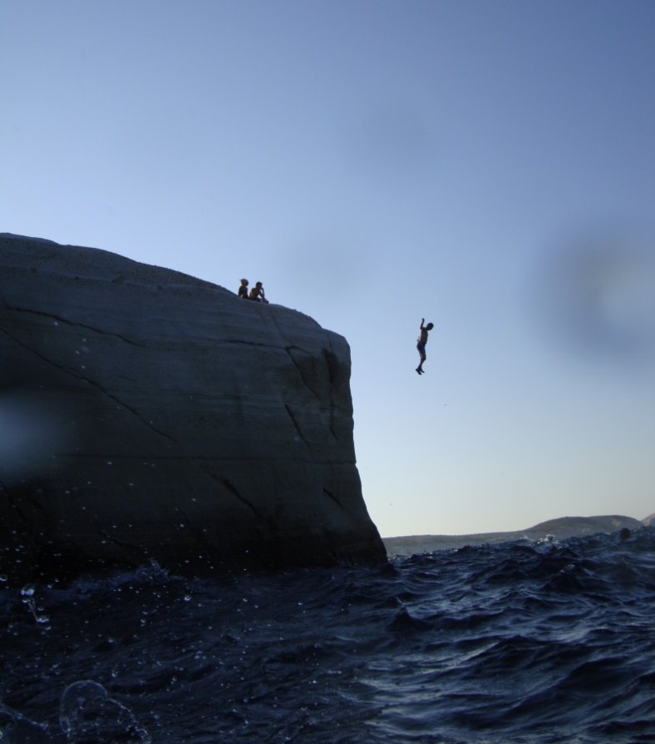
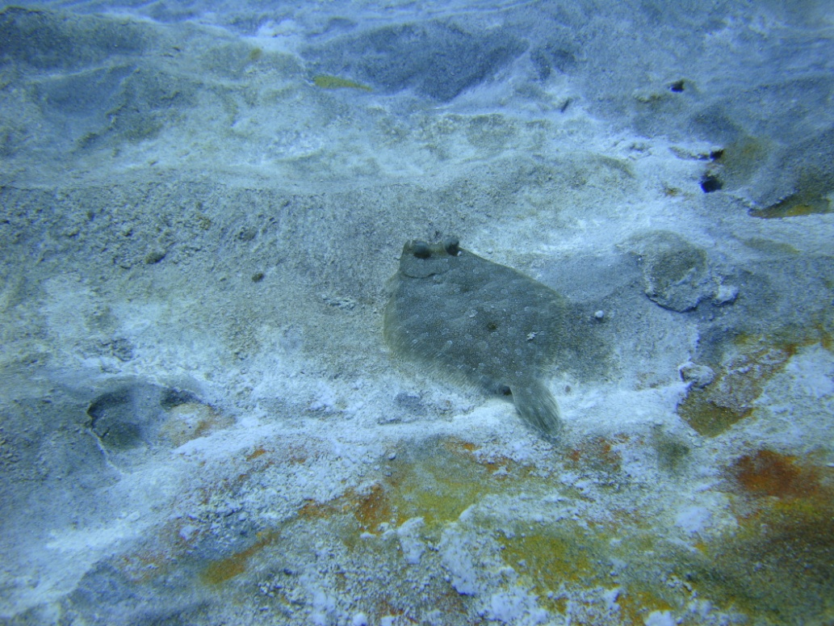
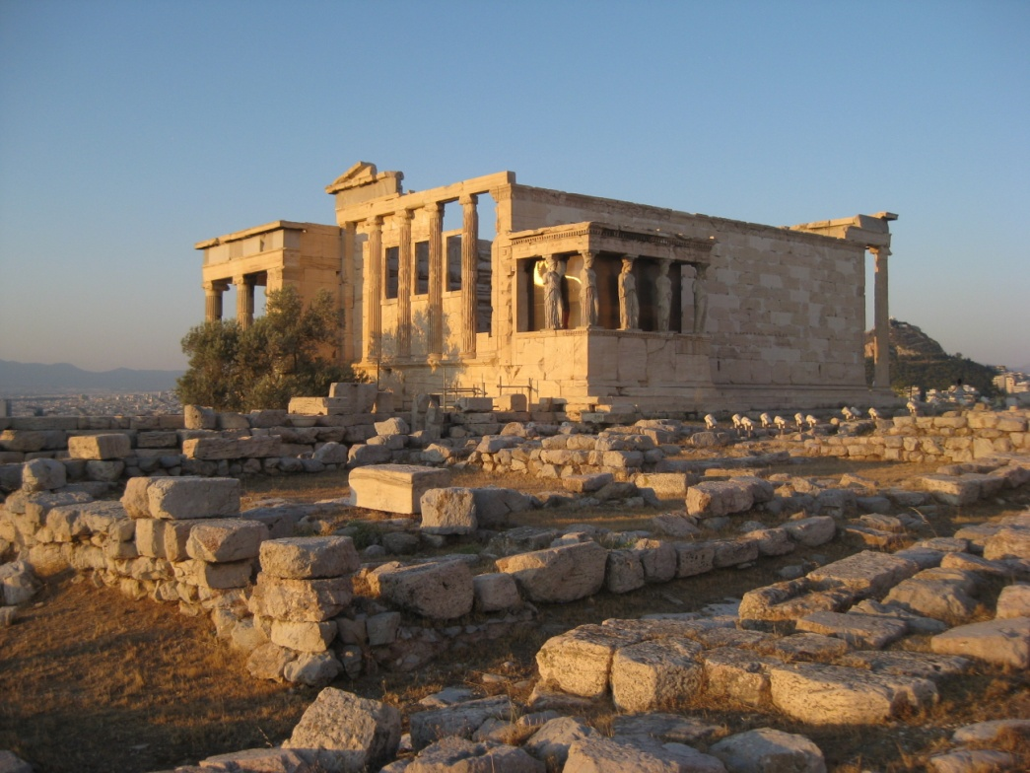
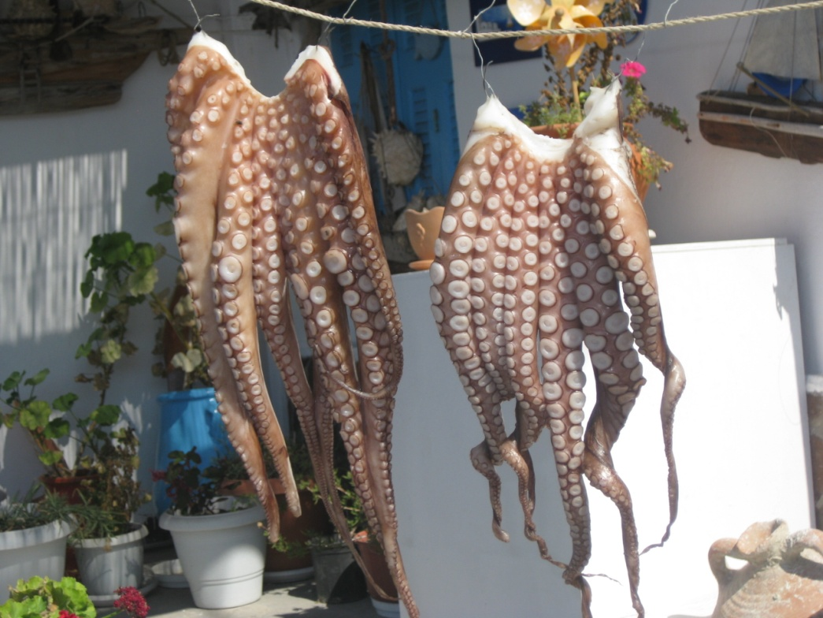
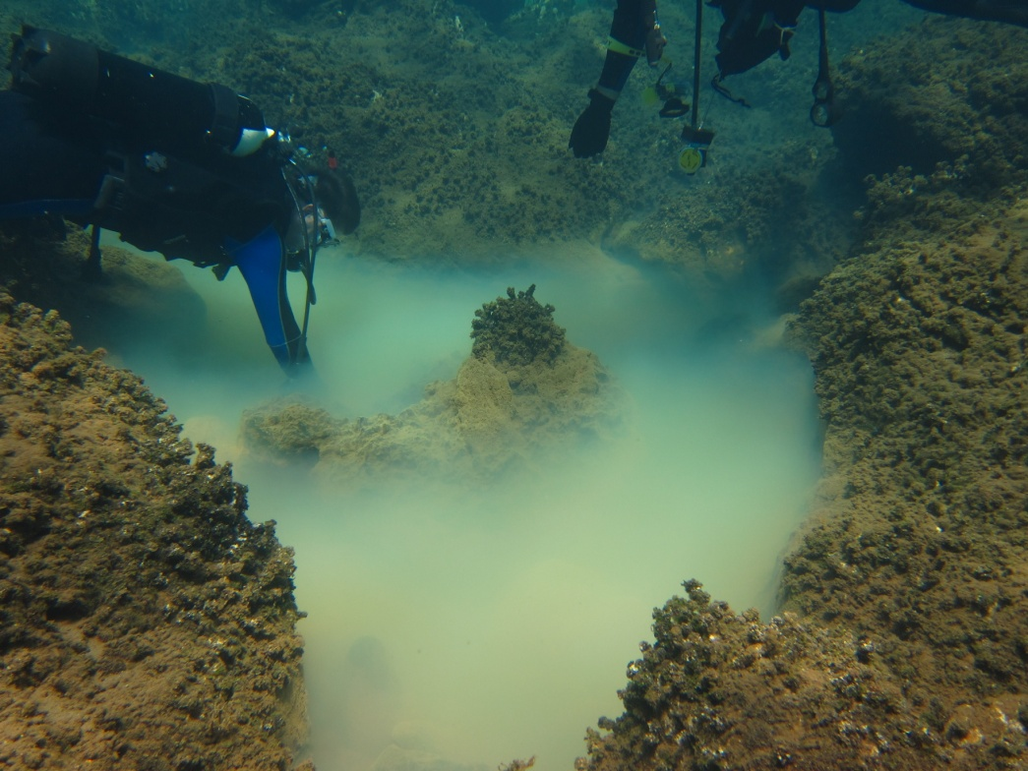
Microbial geochemistry of arsenic (As)
Ambitle Island (PNG)
Milos Island (Greece)
Center for Dark Energy Biosphere Investigations (C-DEBI)
COSEE-West: Amend, SOME LIKE IT HOT … AND TOXIC
Notes:
43

Slide 44
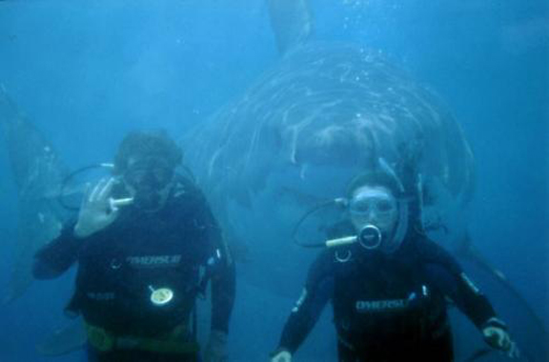
Questions???
Center for Dark Energy Biosphere Investigations (C-DEBI)
COSEE-West: Amend, SOME LIKE IT HOT … AND TOXIC
Notes:
44

Slide 45
Center for Dark Energy Biosphere Investigations (C-DEBI)
COSEE-West: Amend, SOME LIKE IT HOT … AND TOXIC
Notes:
45

Slide 46
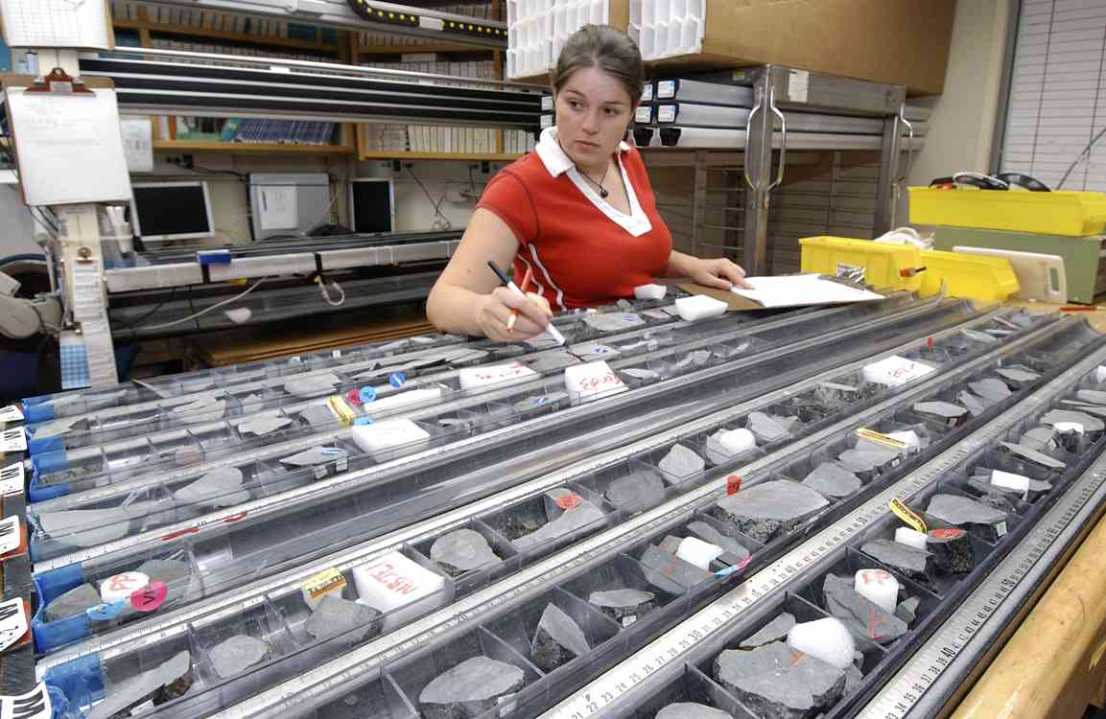
Historical Perspective
IODP: Integrated Ocean Drilling Program: 2003-2013
ODP: Ocean Drilling Program: 1983-2003
DSDP: Deep-sea Drilling Project: 1966-1983
Center for Dark Energy Biosphere Investigations (C-DEBI)
COSEE-West: Amend, SOME LIKE IT HOT … AND TOXIC
Notes:
46

